Slide 1

Automation Software and Design Pattern
MultiBox Palletizer

Slide 2
This machine has three units
1. FEEDER
2. CRANE
3. PALLET
The objective:
To create pallets containing:
two layers of 14 boxes each
each layer is formed by 3 lines of boxes with 2 different orientations
the box orientations is alternated among layers
A cardboard must be included at the bottom of each box layer

Slide 3
MAIN PROGRAM
Manages the over all of the machine and allows subcomponents to communicates
WAIT_START
BOX_ON_FEEDER
BOX_ON_CRANE
HOLD_PALLET_READY
BOX_ON_PALLET
PALLET_ON_EXIT
WAIT_START
BOX_ON_FEEDER
BOX_ON_CRANE
HOLD_PALLET_READY
BOX_ON_PALLET
PALLET_ON_EXIT
EMGCY_STOP
IMMEDIATE_ON_PHASE_STOP

Slide 4
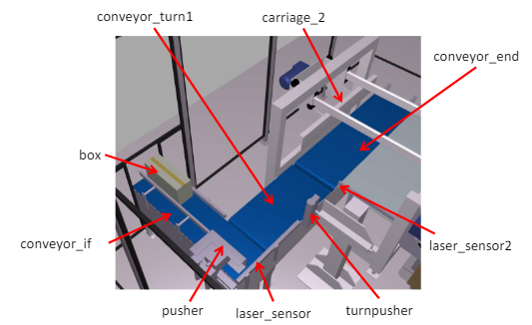
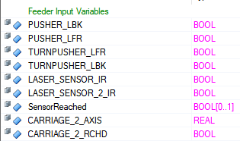
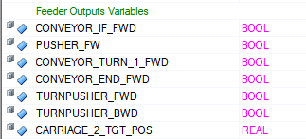
1. The Feeder
Carries three lines of boxes to the crane following a specific patterns

Slide 5
FEEDER PROGRAM
WAIT_START
CONVY_IF_START
LASER_SENSOR_IR_1
PUSHER_ENABLE_STATE
PUSHER_DISABLE_STATE
CONFIRM_TURN_PUSHER_DISABLE
CONFIRM_TURN_PUSHER_ENABLE
PUSHER_STATE
CONFIRM_CONVY_TURN_AND_END
LASER_SENSOR_IR_2
WAIT_FOR_NUMBER_OF_BX
PUSH_NUMBER_OF_BOXES
CONFIRM_CONVY_END_STOPPED
PLACE_BOXES_ON_CRANE
CONFIRM_CARRIAGE_REACHED
RESTART_RETURN_CARRIAGE
CONFIRM_CARRIAGE_RETURN
CONFIRM_CONVY_TURN_STOPPED
WAIT_START
CONVY_IF_START
LASER_SENSOR_IR_1
PUSHER_ENABLE_STATE
PUSHER_DISABLE_STATE
CONFIRM_TURN_PUSHER_DISABLE
CONFIRM_TURN_PUSHER_ENABLE
PUSHER_STATE
CONFIRM_CONVY_TURN_AND_END
LASER_SENSOR_IR_2
WAIT_FOR_NUMBER_OF_BX
PUSH_NUMBER_OF_BOXES
CONFIRM_CONVY_END_STOPPED
PLACE_BOXES_ON_CRANE
CONFIRM_CARRIAGE_REACHED
RESTART_RETURN_CARRIAGE
CONFIRM_CARRIAGE_RETURN
CONFIRM_CONVY_TURN_STOPPED
CONFIRM_STOP
FEEDER_FAULT

Slide 6
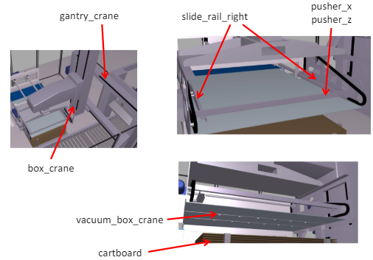

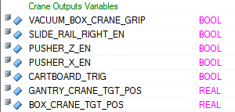
2. Crane
Transports the boxes to the pallet and drops them after laying a sheet of cardboard on the pallet at first layer of boxes.

Slide 7
CRANE PROGRAM
WAIT_START
GC_TARGET_POS_TO_LOAD_BOXES
B_CRANE_CARTLOAD_POS
TRGT_POS_TO_LD_BOXES_AND_CRTBRD
B_CRANE_POS_TO_LD_BX
CONFIRM_PUSHERZ_ENABLED
CONFIRM_PUSHERX_ENABLED
CONFIRM_CARTBOARD_DISABLED
WAIT_FOR_BOX_LD_ON_CRANE
CONFIRM_SLIDERAIL_ENABLED
CONFIRM_PUSHERZ_DISABLED
CONFIRM_PUSHERX_DISABLED
CNFRM_PUSHERZ_ENBLD_AND_PL_READY
BOX_CRANE_TO_PLACE_FIRST_LAYER
BOX_CRANE_TO_PLACE_SECOND_LAYER
GC_TRGT_POS_TO_PLC_CARTBD_ON_PLT
CONFIRM_GC_TO_PLACE_CRT_PL
GC_TRGT_POS_TO_PLC_BX_LYR_ON_PLT
CONFIRM_GC_REACH_POS
GC_TRGT_POS_TO_LD_BX_AND_CRTBRD
CNFRM_GC_REACH_AND_PUSHERX_ENBLD
WAIT_START
GC_TARGET_POS_TO_LOAD_BOXES
B_CRANE_CARTLOAD_POS
TRGT_POS_TO_LD_BOXES_AND_CRTBRD
B_CRANE_POS_TO_LD_BX
CONFIRM_PUSHERZ_ENABLED
CONFIRM_PUSHERX_ENABLED
CONFIRM_CARTBOARD_DISABLED
WAIT_FOR_BOX_LD_ON_CRANE
CONFIRM_SLIDERAIL_ENABLED
CONFIRM_PUSHERZ_DISABLED
CONFIRM_PUSHERX_DISABLED
CNFRM_PUSHERZ_ENBLD_AND_PL_READY
BOX_CRANE_TO_PLACE_FIRST_LAYER
BOX_CRANE_TO_PLACE_SECOND_LAYER
GC_TRGT_POS_TO_PLC_CARTBD_ON_PLT
CONFIRM_GC_TO_PLACE_CRT_PL
GC_TRGT_POS_TO_PLC_BX_LYR_ON_PLT
CONFIRM_GC_REACH_POS
GC_TRGT_POS_TO_LD_BX_AND_CRTBRD
CNFRM_GC_REACH_AND_PUSHERX_ENBLD
CONFIRM_STOP
FEEDER_FAULT

Slide 8
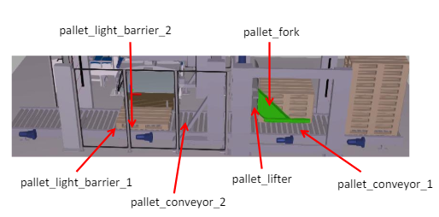


3. Pallet handler
Prepare pallets and bring them to the right position, waiting for the boxes to be dropped

Slide 9
WAIT_START
PL_LIFTER_MOVE_DOWN
PL_FORK_OPEN
PL_LIFTER_BACK_TO_POS
PL_FORK_LOCKED
PL_LIFTER_LOCKED
START_PL_CONVY_1
START_PL_CONVY_2
LIGHT_BARRIER_2
CONFIRM_PL_CONVY_1_STOP
CONFIRM_PL_CONVY_2_VELOCITY
LIGHT_BARRIER_1
CONFIRM_PL_CONVY_2_STOP
WAIT_FOR_LAYERS_OF_BOX
PL_EXIT
PALLET PROGRAM
WAIT_START
PL_LIFTER_MOVE_DOWN
PL_FORK_OPEN
PL_LIFTER_BACK_TO_POS
PL_FORK_LOCKED
PL_LIFTER_LOCKED
START_PL_CONVY_1
START_PL_CONVY_2
LIGHT_BARRIER_2
CONFIRM_PL_CONVY_1_STOP
CONFIRM_PL_CONVY_2_VELOCITY
LIGHT_BARRIER_1
CONFIRM_PL_CONVY_2_STOP
WAIT_FOR_LAYERS_OF_BOX
PL_EXIT
CONFIRM_STOP
FEEDER_FAULT

Slide 10
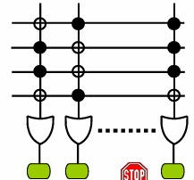
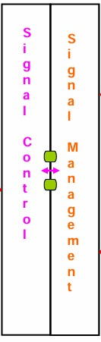
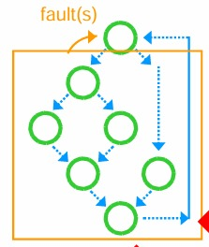
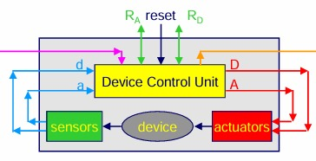
Signal Management
Output Signals
MAIN PROG.
FEEDER PROG.
CRANE PROG.
PALLET PROG.
Devices
Faults: Activation Signals

Slide 11

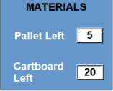
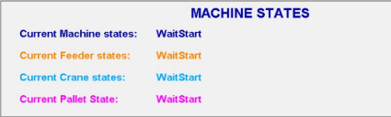
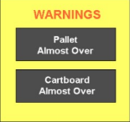

Human Machine Interface HMI

Slide 12

Normal Operating condition

Slide 13

Types of Stops
Emergency Stop
Immediate Stop
On_Phase Stop
Material out of stock

Slide 14

Output Signals and Activation signal
Immediate Stop:
mConveyorIfFault
mBoxCraneFault
mPalletforkFault
On Phase Stop:
monphasestop_request
mPalletsover
mCartboardover
Emergency Stop:
mEmergencyStopRequest

Slide 15

Material Management
Materials: Box, Palletizer and Cardboard :
ALARM:
If(Counter=0)
Immediate_Stop_Request
WARNING :
If(Counter=1, i.eAlmost_over)
OutputSignals

Slide 16

On phase stop and Emergency stop

Slide 17

Immediate stop and Fault clearance

Slide 18

Libraries used
SignalManagement
GenericDevices
GenericAxis

Slide 19

Signal management Library
START_CONFIGURATION(reset signal counter)
CONFIGURATION(counting signals)
START_GENERATION(ready for generating)
GENERATION(generate and manage)
RUN(synchronize the signal to HMI)
Manages the faults, anomalies, warnings, informations and stops that can happen during the operation of the machine

Slide 20
One time run
START_CONFIGURATION
Reset signals counts
CONFIGURATION
Counting All type of signals
GENERATION
Update number of Active signal based on their signal type
If(Signal is Active and Not Registered)
Register Signal
Increment Index
Register Signal code of Active Signal
3. If(Condition to Reset signal is meet)
Set(ResetEnable)
4. If(Reset key is pressed and other conditions meet)
Reset Signal from Signals
Remove Signal from ActiveSignalCodes
Decrement Index
Reset(ResetActivation)
5. Update Number of ActiveSignals(Alarm, Anomalies, Warning, Information)
6. Update SignalOutputs
7. Update the user Interface
START_GENERATION
Reset :
AuxResetEnable
ResetEnable
SignalOutputs
ResetActivation
AuxResetActivation

Slide 21
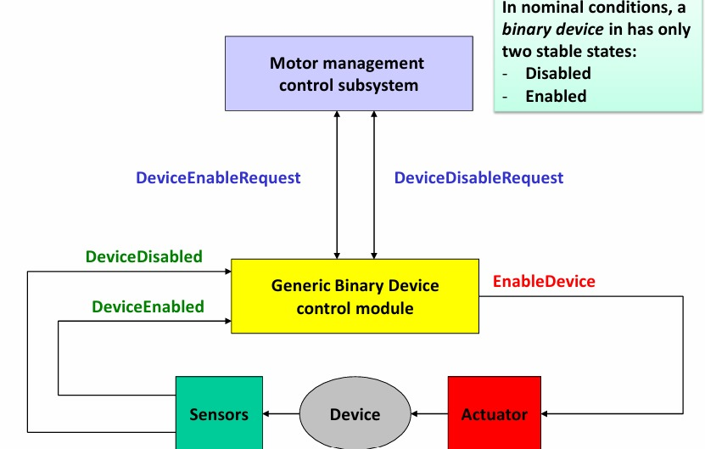
Generic Devices Library

Slide 22
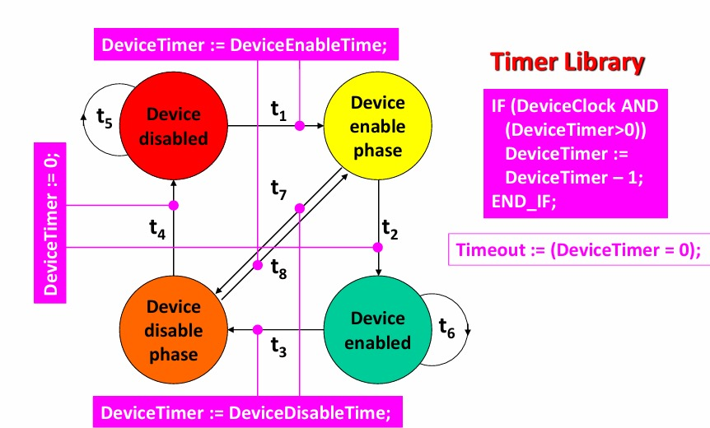
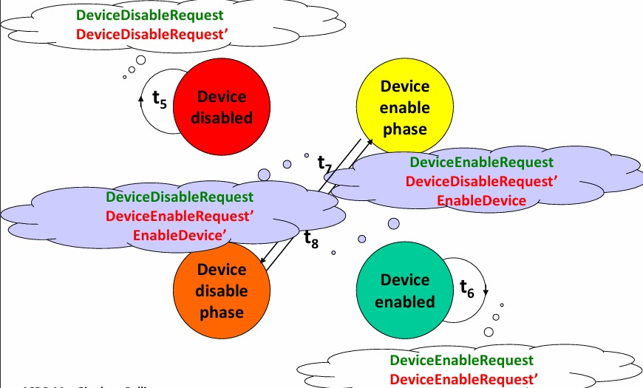
FSM IMPLEMENTATION

Slide 23
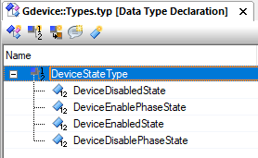
Generic Devices: States

Slide 24
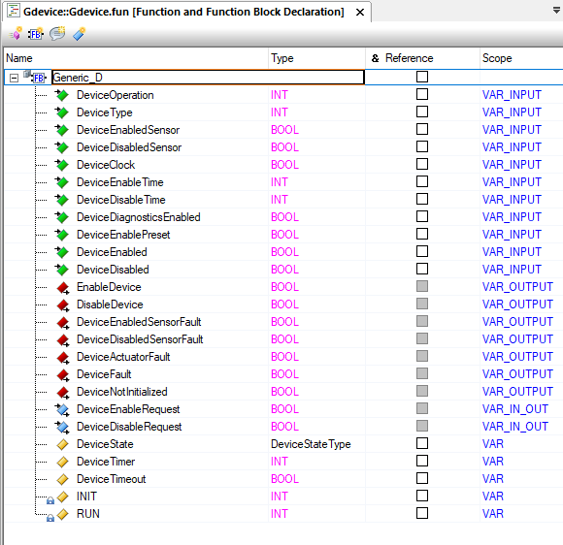
Generic Device: Inputs and Outputs Variables

Slide 25
Generic Axis:
State Machine: 4 Axis State
WAIT
SET_POSITION
SET_VELOCITY
GA_FAULT

Slide 26
Generic Axis State Transition
Check command and move to new state to execute the given command
Check Execute
If(Idle): Loop
DONE
DONE
Change_Position
If(target position reached):
Return to check Execute
Else: (Timer = 0) DeviceFault:=TRUE
move to FaultState
Change_Velocity
If(CurrentVelocity):
Return to check command
Else: (Timer = 0) DeviceFault:=TRUE
move to FaultState;
RESET FAULTS
Faults state
FAULTS
FAULTS

